Slide 1


Inquiry Teaching Practices and The Effect of Mindset

Slide 2

Your Presenters
Amanda Gonczi
Ph. D. Science Education
M.S. Curriculum & Instruction
B.S. Resource Management
Science Teacher for 8 years

Slide 3

Your Presenters
Laura Chervenak
  VP of Professional Development
  at ExploreLearning
  M.S. Anthropology
  B.A. Zoology
  School leader for 8 years
  Science teacher for 9 years

Slide 4
Our Goals Today
Understand what inquiry teaching is and its importance in science classrooms.
Understand what mindset is.
Understand how a fixed teaching mindset can influence teachers’ behavior and willingness to adopt new instructional strategies.
Know how to promote a growth teaching mindset and adoption of inquiry-based teaching practices through verbal interactions and expectations with teachers.

Slide 5

What is Inquiry?
Scientific inquiry - the process scientists go through to answer a research question (collect and analyze data)
Inquiry teaching – instruction that allows students the opportunity to answer research questions through data collection and analysis

Slide 6
Inquiry-Based Lesson: Student Actions
Inquiry Levels | Data collection & analysis: Practice # 4 | Question: Practice #1 | Methods: Practice #3 | Solution: Practice # 6
1 confirmatory | 
2 structured |  | 
3 guided |  |  | 
4 open |  |  |  | 

Slide 7
Importance of Inquiry Teaching
Conceptual understanding (Minner, Levy, & Century, 2010)
Interest in science (Gibson & Chase, 2002)
Nature of science understanding (NRC, 2012)
Future scientists (Lave & Wenger, 1991)

Slide 8
Barriers, Barriers and More Barriers!
Limited scientific inquiry experience (Morrison, 2013)
Limited content knowledge (Crawford, 2007)
Limited instructional time (Cheung, 2007)
Beliefs/Alternative conceptions
  Inquiry is…. (Anderson, 2002)
  Standardized curriculum/tests (Crawford, 2007)
  Students (Wheeler, Maeng, Bell, & Whitworth, 2013)

Slide 9
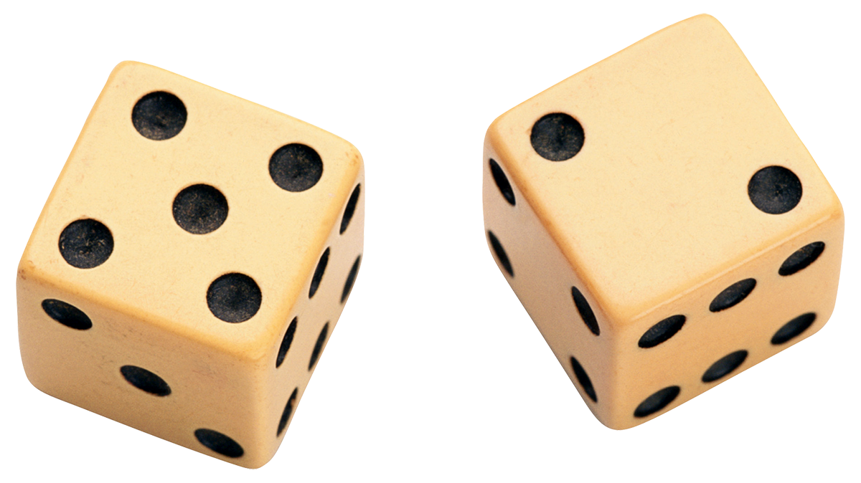
What is Mindset?
A belief in the flexibility of a personal trait characteristic (Dweck, 2006)
  Growth-minded: believe trait is learned or acquired and can be improved upon
  Fixed-minded: believe trait is inherited and cannot really be altered

Slide 10
Mindset Domains
Intelligence (Dweck, Chiu, & Hong, 1995)
Morality (Dweck, Chiu & Hong, 1995)
Math/science ability (Dweck, 2008)
Self-attributes/personality (Dweck, 2008)
A fixed mindset in one domain is independent of mindsets in other domains. (Dweck, 2006)
Mindset is flexible and affected by context (Dweck, 2006; Myrphy & Dweck, 2009)

Slide 11
Mindset & Behavior
  Mindset is an implicit theory that explains components of human behavior and certain outcomes
    Goals (Yaeger & Dweck, 2012)
    Risk-taking behavior (Dweck & Leggett, 1988)
    Perception of failure/emotions (Dweck & Leggett, 1988)
    Judgments on others (Dweck, 2008)

Slide 12
Intelligence Mindset
Fixed
Mindset
Growth Mindset
Intelligence is innate
Intelligence is malleable
Avoid academic risk/challenge
Embrace academic risk/challenge
Perceive failure/difficulty as indicators of intelligence deficit
Perceive failure/difficulty as area for growth
Strong negative emotions
Moderate emotional response
Low achievement
High achievement

Slide 13
Teaching Mindset
Fixed
Mindset
Growth Mindset
Teaching ability is malleable
Adopt new instructional strategies
Change in instructional practices following PD
Teaching ability is innate
Avoid risk/challenge
Limited change following PD

Slide 14
Our Research at UVa
  What are elementary teachers’ teaching mindset
  What relationship, if any exists between teaching mindset and aversion to novelty?
  To what extent can professional development promote a growth teaching mindset?

Slide 15
Measuring Teaching Mindset
  1 2 3 4 5 6
Strongly Agree Strongly Dis.
You have a certain amount of teaching skill and you can’t really do much to change it.
Your teaching ability is something about you that you can’t change very much.
You can learn new things but you really can’t change your basic ability to teach.

Slide 16
Measuring Aversion to Novelty
  1 2 3 4 5
Strongly Agree Strongly Disagree
I would prefer to use teaching strategies that are familiar to me, rather than strategies I would have to learn how to do.
I don’t like to learn a lot of new teaching strategies in professional development.
I prefer to teach as I have always done it, rather than trying something new.
I like using teaching strategies that are familiar to me, rather than those I haven’t thought about before.
I would choose teaching strategies I knew I could implement, rather than strategies I haven’t used.

Slide 17
Teaching Mindset

Slide 18
Novelty Aversion
Pre PD | Mindset (Pearson coefficient)
Avoiding Novelty | .518*, p < .05
Post PD | Mindset (Pearson coefficient)
Avoiding Novelty | .458*, p < . 05

Slide 19
PD & Mindset
  “I think the biggest thing was having the opportunity to actually teach to the campers… So by being able to make a lesson plan and have people observe you and debrief with you and totally constructive. You didn't feel alienated that you were doing anything wrong even if it was something that you could improve on. I think that that was a really great part. So I felt that that allowed me to be able to set the expectation for myself that I can do this when I go back.” (E3CT331, Interview)

Slide 20

Today’s Lesson
Heat Absorption Gizmo
Notes:
Do the script…

Slide 21
Research question?
If [Independent variable] [change],
then
[Dependent variable] will [change].
Notes:
Ask for hypotheses

Slide 22
Continuing…
Be prepared to share your
  Hypothesis
  Results
  Claim
  Evidence
What additional questions would you like to investigate based on your findings or the findings of the other groups?

Slide 23
Putting It All Together
Expectations:
Professional growth
Attempt new instructional strategies
2. Language:
Praise any and all effort, regardless of outcome
Focus on teaching effort, not student outcomes/behavior
Scaffold:
Know your teachers’ inquiry practices
Set small expectations and professional growth goals

